Slide 1
Child Safe Standards
What you need to know and understand
Notes:
What you need to know and understand about Child Safe Standards

Slide 2
Overview
Why are child safe standards required?
What are the standards?
What do I need to do to meet the standards?
Requirements and criteria to meet standards
Notes:
Why the Child Safe Standards are required
What they are
What we need to do to meet the standards
What the requirements and criteria are for each standard

Slide 3

Why are the Child Safe Standards necessary?
The Child Safe Standards recommended by the Royal Commission into Institutional Responses to Child Sexual Abuse provide a framework so organisations can create cultures and adopt strategies to keep children safe from harm.
“Policies and procedures are not enough on their own to protect children from harm”
Notes:
The Royal Commission into Institutional Responses to Child Sexual Abuse (the Royal Commission) shone a spotlight on thousands of cases where organisations in Australia failed to protect children in their care from abuse. It highlighted that abuse that occurs within an organisational context is not just a problem of the past, it continues today.
The Child Safe Standards recommended by the Royal Commission provide a framework so organisations can create cultures and adopt strategies to keep children safe from harm.
The key reasons for the development of the child safe standards are:
To make organisations safe for children
To ensure mechanisms for making complaints
To include children, young people and their families in key decisions
To ensure that only appropriate persons work with children
The vasty majority of staff in organisations place children first and are motivated to do what is best for them. Organisations and people working with children in NSW share responsibility for keeping children safe. Applying the Standards makes it easier for children, parents, carers and staff to share their understanding of child safety across different settings. The Standards promote consistency across care environments.

Slide 4
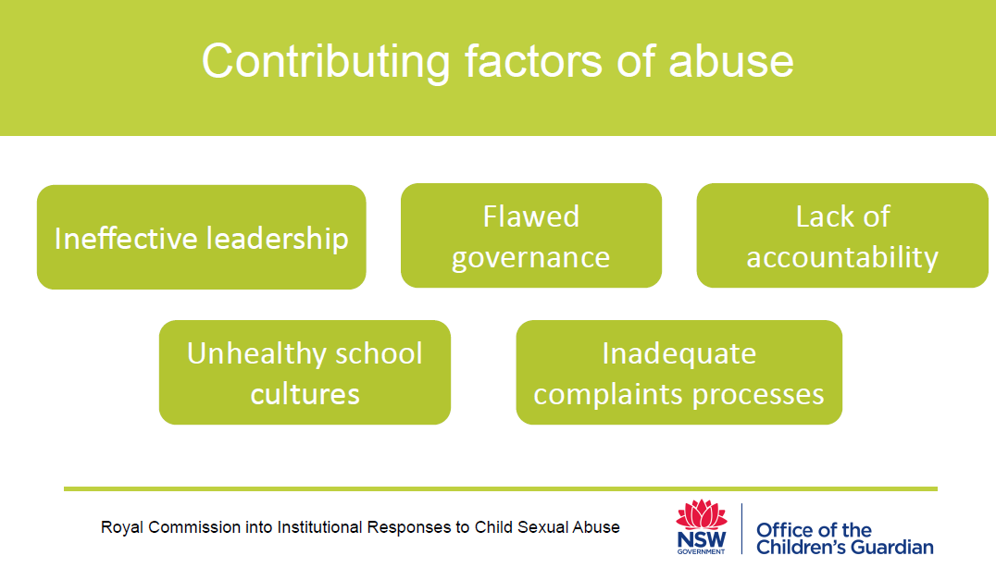
Notes:
The Royal Commission found that these were the key factors that contributed to abuse occurring:
Ineffective leadership
Flawed governance
Unhealthy school cultures
Lack of accountability
Inadequate complaints processes
A child safe organisation is a set of values and practices that guide the attitudes and behaviour of all staff. Good leaders champion these values and embed them in organisational governance. The following values should be at the heart of any approach that prioritises children’s safety:
• The best interests of children and their protection from harm is paramount.
• Child abuse is not tolerated and must not happen.
• Children’s rights are understood and respected.
• Concerns about child safety raised by children and their parents and carers are acted on.
• Reporting abuse is not obstructed or prevented.
(You may identify that a lot of these key themes have been addressed in the Diocese Rights of the Child Framework, we looked at earlier).

Slide 5
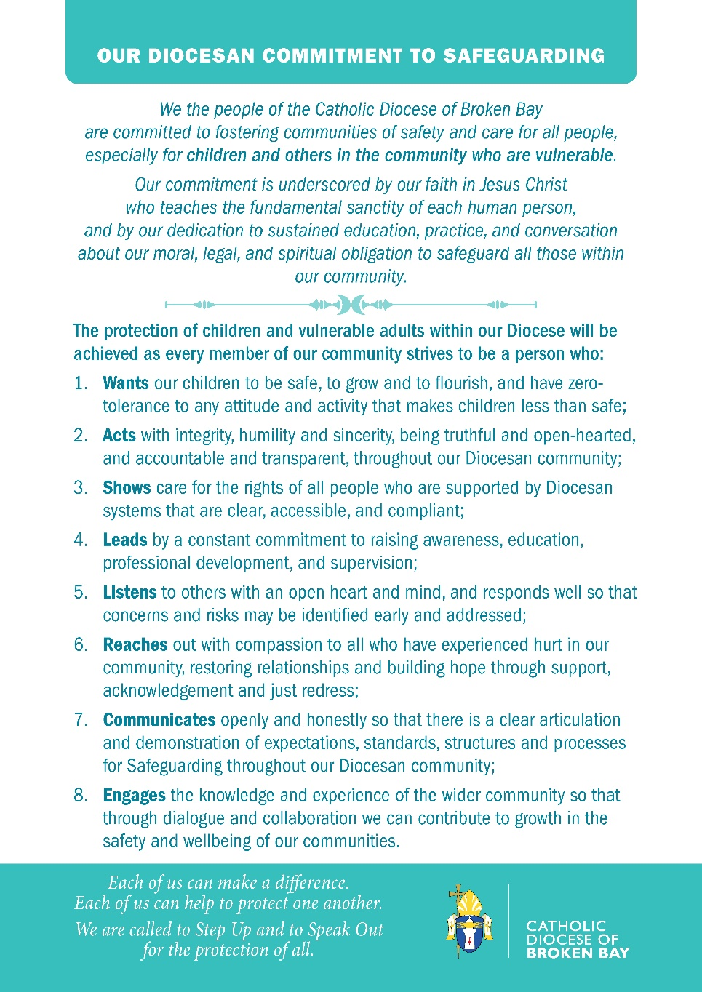

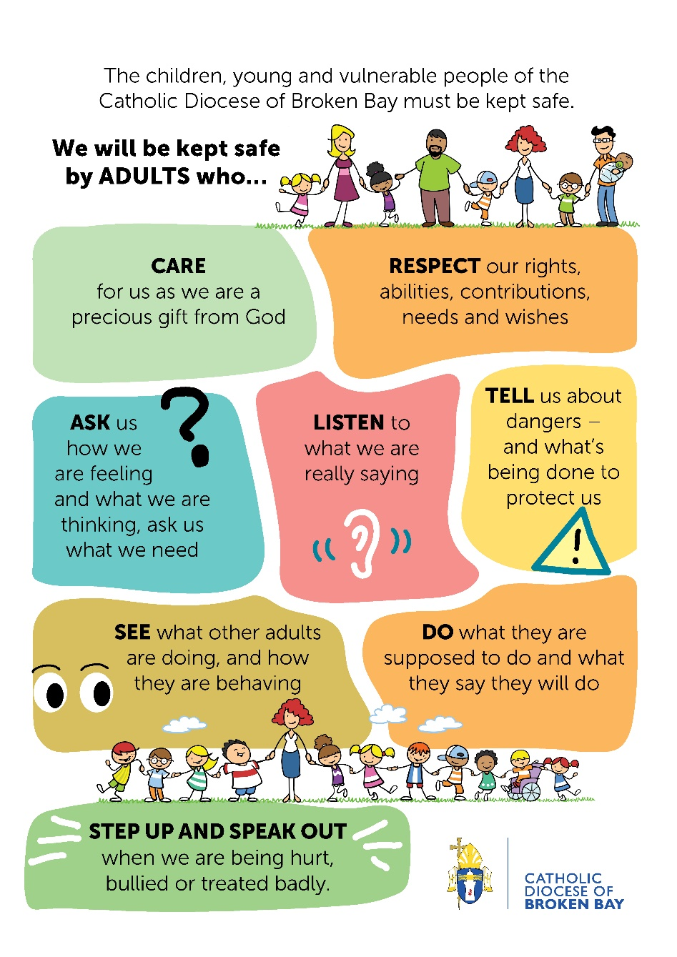
Our Commitment to Safeguarding
Commitment Statement Card
Keep Me Safe
Notes:
All of these values (that champion a child safe organisation) have been incorporated into the Diocese of BB commitment to Safeguarding.
The Diocesan Commitment to Safeguarding was published 18 months ago.
Commitment Statement Cards look like this (Hold up card).
If you don’t have a card please take one with you. If you do you can leave it behind.
Today we will recommit to this statement by watching the video released with the statement.
View DBB Safeguarding cartoon video called Keep Me Safe. - https://www.youtube.com/watch?v=VScmMdmZ_1Y&t=12s (2:17)

Slide 6
Historical events leading to the formation of the National Principles for Child Safe Organisations
Child Safe Organisations Project
National Children’s Commissioner led the development of National Principles for Child Safe Organisations
Australian Human Rights Commission
Develop practical tools to help organisations implement the National Principles
Community Services Ministers
National Framework for Protecting Children 2009 - 2020
Royal Commission into Institutional Responses to Child Sexual Abuse
Responds to the recommendations made by the Royal Commission into Institutional Response to Child Sexual Abuse
Notes:
What were the historical events/background leading to the formation of the 10 standards:
In 2009 there was a National coalition made up of Commonwealth, State and Territory government and non governments Agencies who had a long term plan of reducing Child Abuse and neglect in Australia from 2009 – 2020.
In 2012, Julia Gillard announced that there would be a Royal Commission into Child Sexual Abuse. The RC commenced around 2013 and the key findings were tabled in 2017. The Royal Commission found that many organisations in Australia failed to protect children from abuse, failed to listen to children who tried to disclose abuse, and failed to respond appropriately when abuse came to light.
To help ensure that this does not happen again, in its final report in 2017, the Royal Commission set out ten standards for making institutions in Australia child safe. It recommended that the standards be adopted as part of the National Principles for Child Safe Organisations, and that the Council of Australian Governments endorse the National Principles. The Government did endorse the Principles along with other key recommendations.
The National Principles of a Child Safe Organisation requires all institutions who provide child related work for the Government including Commonwealth Agencies to meet the Child Safe Standards.
State and territory governments require all institutions in their jurisdictions that engage in child-related work to meet the child safe standards
As there needed to be support by way of practical tools to help organisations implement the National Principles, the Australian Government commissioned the Australian Human Rights Commission to develop these practical tools.

Slide 7
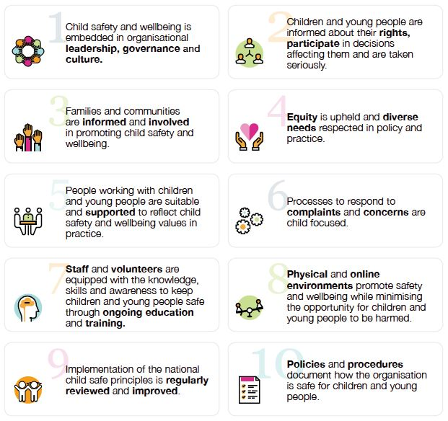
National Principles for Child Safe Organisations
Aim to provide a nationally consistent approach to creating organisational cultures that foster child safety and wellbeing across all sectors in Australia.
Notes:
In summary……The National Principles aim to provide a nationally consistent approach to creating organisational cultures that foster child safety and wellbeing across all sectors in Australia. This will help to keep children and young people safe and reduce future harm in organisational settings.
The National Principles reflect the ten child safe standards recommended by the Royal Commission, with a broader scope that goes beyond child sexual abuse to cover other forms of harm to children and young people.
As of February 2019, the National Principles were endorsed by members of the Council of Australian Governments, including the Prime Minister and state and territory First Ministers.
Meaning that CSBB must adhere to the Principles in the work that we do.

Slide 8
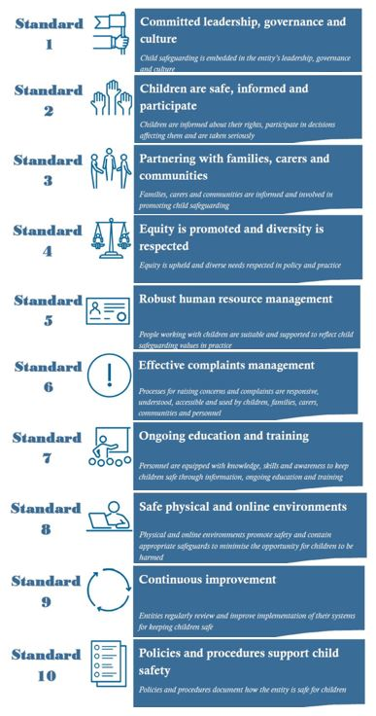
The 10 National Catholic Safeguarding Standards (NCSS) developed by ACSL
Why Safeguards matter?
Notes:
The Catholic Church leadership established CPSL (Catholic Professional Standards Ltd) in response to issues emerging from the Royal Commission.
Under its Constitution Catholic Professional Standards Ltd established national standards for the protection of children, to assist Church entities in implementing the standards, to audit compliance and to publicly report the results.
In early 2018 CPSL developed draft Standards, then set out to test and refine the draft by engaging with Church authorities, survivors, their families and representatives in a broad consultation process.
CPSL has since been incorporated into the newly formed Australian Catholic Safeguarding Ltd or ACSL.
ACSL is committed to fostering a culture of safety and care for children and vulnerable adults by developing the National Catholic Safeguarding Standards.
Refer to Edition ONE 2019: current edition. There will be a review of the Standards in light of experience, and if necessary, changes will be made.
We are now going to watch a short video with Robert Fitzgerald, Former Commissioner with the Royal Commission into Institutional Responses to Child Sexual Abuse.
Video: Why Safeguards matter? - https://www.youtube.com/watch?v=ML83WlNjquc&feature=youtu.be (2:19)
Once again, The National Catholic Safeguarding Standards reflect the Royal Commission standards and the National Principles of Child Safe Organisations in a very similar structure.
We have not signed up yet with the National Catholic Safeguarding Standards, but we will be.
We will discuss more about what the NCSS means for CSBB later in the presentation.

Slide 9
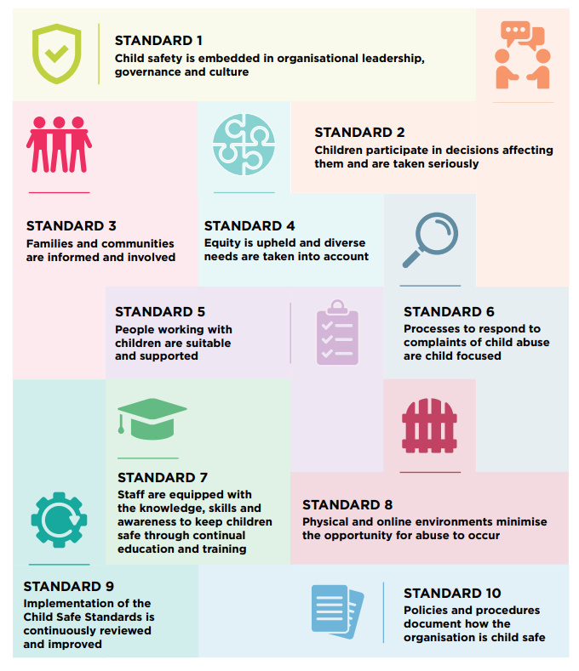
NSW Child Safe Standards
Notes:
Similar to the NCSS and the National Principles for a Child Safe Organisation, there also state government standards called the NSW Child Safe Standards. These have been developed by the Office of the Children’s Guardian.
It provides a framework for making organisations safer for children. The Standards provide tangible guidance for organisations to create cultures, adopt strategies and act to put the interests of children first, to keep them safe from harm.
The Standards have been designed to:
• help drive cultural change in organisations
• be principle-based and outcome-focused
• be flexible enough that they can be adapted by organisations of varying sizes and characteristics
• avoid placing undue burden on organisations
• help organisations address multiple risks
• balance caution and caring
• be a benchmark against which organisations can assess their child safe capability and set performance targets
• be of equal importance and interrelated.

Slide 10
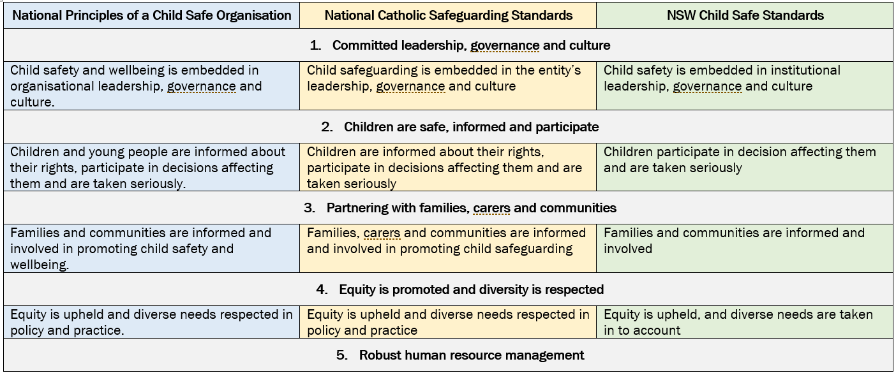
Comparison of Child Safe/Safeguarding Standards
Notes:
If you refer to your packs, this Resource sheet has an overview of all 3 Standards side by side.
The main points are:
The Child Safe Standards are consistent across the 3 levels: NCSS; NSW Child Safe Standards; and the overarching National Principles of a Child Safe Organisation.
All Standards were derived from the recommendations of the Royal Commission.
We will be subject to an Audit under the NSW Child Safe Standards. If we’re compliant with one, we’ll be compliant with all of them.

Slide 11
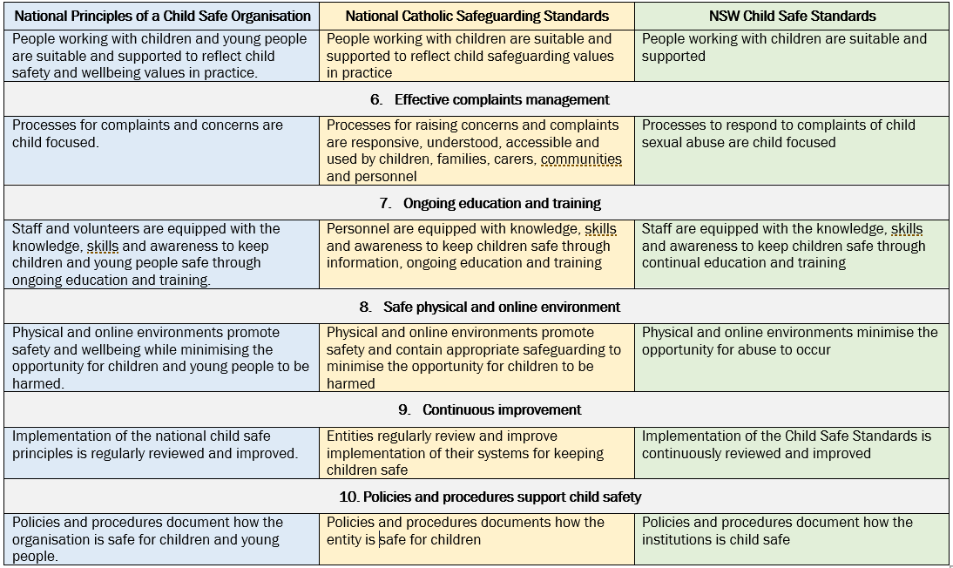
Comparison of Child Safe/Safeguarding Standards
Notes:
2nd page of the Resource/ handout.

Slide 12




How the standards fit together ether
Leadership, monitoring & improvement
STANDARDS
1 & 9
Engaging with children, families & communities
STANDARDS
2, 3, 4
Right people, right role, right knowledge
STANDARDS
5 & 7
Systems, policies and procedures
STANDARDS
6, 8, 10
Notes:
To make the standards not so overwhelming, CPSL (Catholic Professional Standards Ltd) have grouped the standards into 4 groups with a title that encompasses the desired outcome of the standards.
We will explore these 4 groups a little more and provide key elements of each.
The NCSS also has an implementation guide. (Hold up the Guide). (Page 4 of the NCSS refers to Support materials, education and training, implementation and review details and resources).
Use the Handouts from the previous slide to follow along as we discuss how the Standards fit together.

Slide 13
Leadership, monitoring & improvement
STANDARDS 1 & 9
Notes:
The first lot of desired outcomes refers to having strong leadership and mechanisms for monitoring and improving the safeguarding culture of the organisation.
They are based on Standards 1 & 9.
--------
Standard 1: states that Child Safeguarding is embedded in the Institution’s leadership, governance and culture
Standard 9: that there is Continuous improvement: Entities regularly review and improve implementation of their systems for keeping children safe.

Slide 14
Key Elements of Standard 1
A commitment to safeguarding
Promoting a Safeguarding Culture
Safeguarding Policies
Code of Conduct
Notes:
Standard 1: states that Child Safeguarding is embedded in the Institution’s leadership, governance and culture
Why is Standard 1 important?
If we have a leadership team that is committed to providing safe environments, children are less likely to be exposed to harm and abuse.
A child safe culture is a set of values and practices that guide the attitudes and behaviour of all staff. Good leaders champion these values and embed them in organisational governance.
Leadership that keeps children safe is demonstrated by personal behaviour, having child safe practices, putting children first, prioritising training and education, and having a culture of continuous improvement.
Leadership extends to all staff as they share the responsibility for keeping children safe.
What should we be doing?
• The organisation makes a public commitment to child safety, and leaders champion a child safe culture both inside and outside the organisation.
How do you champion a Child Safe Culture?
By:
Creating a safe space for children to make disclosures where the child’s voice is always heard and believed;
Increased awareness of risk and how to mitigate risk – having a child protection lens in all areas of the community;
Oversight from the Safeguarding office, where experienced practitioners provide advice and guidance based on current/relevant field experience and are up to date with evidence based practice, and
Through research and changes in the government and NGO sector.
Child safety is a shared responsibility at all levels of the organisation.
• Risk management plans focus on identifying, preventing and lowering risks to children.
• Staff understand and comply with Codes of Conduct that sets clear behavioural standards when interacting with children. volunteers/contractors. Basically our policies and procedures that ensure our organisation is child safe.
• Staff understand their obligations in reporting, sharing information and keeping records.
What questions can we ask to reflect on what we are doing?
• How do leaders champion a child safe culture in our organisation?
• How do leaders ensure we have effective child safe risk management strategies?
• How do leaders set expectations of how our staff behave towards children?
• How do our workers share the responsibility for keeping children safe?
• What activities exist to reinforce a child safe culture in our organisation?
Provide examples:
Regular professional development; today’s training for example, online webinars, advisory groups.
Governance: Charter for Safeguarding; Rights of the Child; WWC; Declarations for volunteers/contractors. Basically our policies and procedures that ensure our organisation is child safe.
Culture: Creating a safe space for children to make disclosures where the child’s voice is always heard and believed;
Increased awareness of risk and how to mitigate risk – having a child protection lens in all areas of the community;
Oversight from the Safeguarding office, where experienced practitioners provide advice and guidance based on current/relevant field experience and are up to date with evidence based practice,
Research and changes in the government and NGO sector.

Slide 15
Key Elements of Standard 9
Review
Analysis
Practice
Continual improvement
Notes:
Standard 9: refers to Continuous improvement. Entities regularly review and improve implementation of their systems for keeping children safe.
Why is this Standard important?
Child Safe Standards are principle-based and are more effective if their implementation is continuously reviewed and improved.
Being a child safe organisation is an evolving process that requires ongoing efforts to keep children safe.
Child safe organisations that have an open and transparent culture learn from their mistakes and put the interests of children first.
What should we be doing?
We should be…
• Regularly reviewing and improving our child safe practices.
• And analysing complaints to identify causes and systemic failures and inform continuous improvement.
What questions can we ask to reflect on what we are doing?
• How do we stay up to date with current knowledge of child safe practices?
• How do we change policies and procedures to reflect changes to child safe practices?
• Do we review our child safe policies and procedures following a complaint?
• Has an independent agency reviewed our child safe policies and practices? • How would we conduct a root cause analysis after a critical incident?

Slide 16
Engaging with children, families & communities
STANDARDS 2, 3 & 4
Notes:
The next group of standards relate to our engagement with children, families and communities
Based on Standards 2, 3 & 4
------------------------
Standard 2: Children are safe, informed and participate
Standard 3: Partnering with families, carers and communities
Standard 4: Equity is promoted and diversity is respected

Slide 17
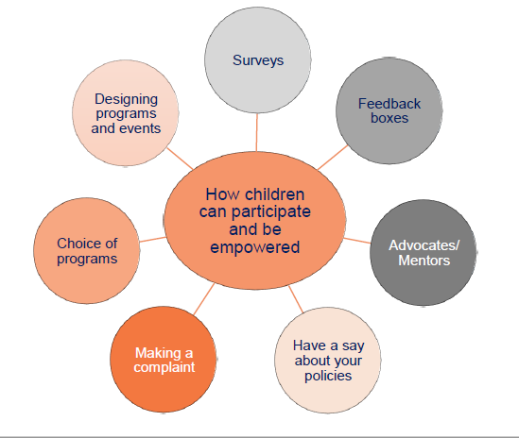
Key Elements of Standard 2
How can children participate and be empowered?
Notes:
Standard 2: Children are safe, informed and participate
Why is this Standard important?
A child safe organisation values children and identifies opportunities for them to participate in decisions that affect them. Empowering children by supporting them to take part in discussions about their safety is a reliable indicator that your organisation is child safe. This ‘protection through participation’ gives children the confidence and ability to speak up if they’re being harmed or abused, or feel unsafe.
What should we be doing in this space?.....
• Children are able to express their views and are provided opportunities to participate in decisions that affect their lives.
• The importance of friendships is recognised and support from peers is encouraged, helping children feel safe and be less isolated.
• Children can access abuse prevention programs and information.
• Staff are attuned to signs of harm and facilitate child-friendly ways for children to communicate and raise their concerns.
What questions can we ask to reflect on what we are doing?
• What opportunities do we offer children so they can give their views?
• How does our organisation act on feedback given by children?
• How do our staff demonstrate they understand the importance of children’s rights?
• How do we actively support children to develop and sustain friendships?
• How do we include children of all ages, abilities and cultural backgrounds?
• How are children given the skills to understand their feelings so they can describe them to adults?
• Does our organisation discourage children from raising particular subjects?

Slide 18

Key elements of Standard 3 -
Partnering with families and communities
How do you actively involve families and communities in your school?
How do you communicate relevant information to your families and communities?
Notes:
Standard 3: relates to Partnering with families, carers and communities. It states “Families, carers and communities are informed and involved in promoting child safeguarding.”
Why is this Standard important?
Parents or carers have primary responsibility for raising their children. Child safe organisations involve families and community members in decisions that affect the children in their care. Children feel more valued when this happens, and when organisations are more accountable for their child safe practices.
What should we be doing?
• Families have the primary responsibility for the upbringing and development of their child and participate in decisions affecting the child.
• Our organisation needs to engage in open, two-way communication with families and communities about its child safety approach, and relevant information is accessible.
• Families and communities have a say in the organisation’s policies and practices.
• Families and communities are informed about the organisation’s operations and governance.
What questions can we ask to reflect on what we are doing?
• How do we actively involve families and communities in our organisation?
• How do families and communities know who our leadership team is?
• Are Codes of Conduct and child safe policies and procedures accessible to families and community members?
• How does our workforce reflect the diversity within our community?
• How would we include families when responding to a complaint of child abuse?
Example: consultation phase when the Professional guidelines for employees was written. Tamara consulted parents and families, executive and students
Example: weekly school newsletters, communications, letters

Slide 19
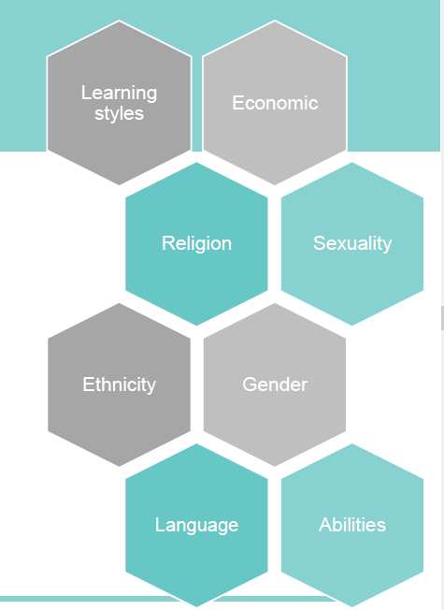
Key elements of Standard 4 -
Equity is upheld and diverse needs are taken into account
Notes:
Standard 4: Equity is promoted and diversity is respected
Why is this Standard important?
Children need to build relationships, skills and knowledge, and have access to resources that keep them safe. Organisations need to adapt to the diverse needs of children, so they have equal opportunities to feel welcome and participate in activities and programs. This can help organisations prevent abuse and empower children to speak up. This fosters an inclusive, open and transparent culture.
What should we be doing?
• The organisation actively anticipates children’s diverse circumstances and responds effectively to those with additional vulnerabilities.
• All children have access to information, support and complaint processes.
• The organisation pays particular attention to the needs of Aboriginal and Torres Strait Islander children, children with disability and children from CALD backgrounds.
What questions can we ask to reflect on what we are doing?
• How does our organisation identify children with vulnerabilities and establish their needs?
• Does our workforce understand the link between a child’s vulnerability and their increased risk of being harmed?
• How are our children given skills and tools to communicate their views and needs?
• How does our organisation adapt and respond to the diverse needs of children?
• How does our organisation encourage children to have positive discussions about diversity?
• How are children provided equitable opportunities to participate in our organisation?
For example, the FLOs, and AEO are involved and providing support to families

Slide 20
Right people, right role, right knowledge
STANDARDS 5 & 7
Notes:
The 3rd group relates to having the right people, right role, and right knowledge.
Standard 5: Robust human resource management
Standard 7: Ongoing education & training

Slide 21

Key elements of Standard 5 - People working with children are suitable and supported
Does our recruitment practice focus on child safety?
Do all relevant staff have WWCC?
How do we supervise and support staff to ensure child safe practices?
Notes:
Standard 5: Robust human resource management
Why is this Standard important?
The WWCC is only one tool of many to support organisations in screening potential staff. Screening processes help prevent unsuitable people from being recruited and can discourage them from applying. Ongoing supervision encourages people to follow policies that can reduce the risk of harm to children. Robust human resource management practices ensure that all staff receive ongoing training to effectively perform their role.
What should we be doing?
• Recruitment, including advertising and screening, emphasises child safety.
• Ensure relevant staff have probity checks.
• Ensure all staff receive an appropriate induction and are aware of their child safety responsibilities, including reporting obligations.
• Supervision and people management have a child safety focus
What questions can we ask to reflect on what we are doing?
• How do our recruitment processes focus on child safety?
• Do all relevant staff have WWCC and reference checks?
• Do we have probationary periods for all staff?
• How does our induction process explain our organisation’s commitment to child safety?
• How does our induction process help our staff understand their obligations to keep children safe?
• How do we supervise and support our staff to encourage child safe practices?
• Do all relevant staff have verified WWCCs, criminal history and reference checks?
Examples:
Pre-recruitment: role requirement & risk management, PD, advertising
Recruitment, including advertising and screening, emphasises child safety- advisable that at least 1 question in interviews have a child protection focus
Relevant staff and volunteers have Working With Children Checks
Code of Conducts and declarations
Form 28 referee checks
All staff and volunteers receive an appropriate induction and are aware of their child safety responsibilities, including reporting obligations
Supervision, professional development and people management have a child safety focus
(Relevant to this Standard: is the CSBB Towards 2025 Strategic Plan: one of the main priorities under Capability and Enablement is attracting, developing and retaining high performing personnel.

Slide 22
Key Elements of Standard 7: Staff are equipped with the knowledge, skills and awareness to keep children safe through continual education and training
A safeguarding training strategy that at a minimum includes:
Code of Conduct (1.1.1)
Safeguarding Risk Management (1.5)
Child Safeguarding Policy and Procedures (1.1.1)
Complaints Handling Policy and Procedures (Standard 6)
Reporting Obligations (Standards 6)
e-Safety Training (Standard 8)
Processes are in place to record and monitor personnel’s participation in induction and training
Notes:
Standard 7: Personnel are equipped with knowledge, skills and awareness to keep children safe through information, ongoing education and training.
Why is this Standard important?
When an organisation has a culture of learning, staff are provided with ongoing education and training in how to keep children safe. Training also supports staff in understanding what abuse looks like, how the environment can enable or deter abuse and behaviours that indicate abuse may be occurring.
Training gives staff confidence to respond to abuse if it is detected. It reinforces the importance of child safety and that it is everyone’s responsibility. Child safe training should extend from front-line staff to managers and boards of directors.
What should we be doing?
• Staff receive training on the nature and indicators of child maltreatment, particularly abuse that occurs in organisations.
• Staff receive training on the organisation’s child safe practices and child protection efforts.
• Staff are supported to develop practical skills in protecting children and responding to disclosures.
What questions can we ask to reflect on what we are doing?
• How are staff made aware of the indicators of abuse and neglect?
• How are staff trained in child safe practices?
• How do we record staff participation in training?
• How do we provide training for staff working in higher-risk roles and situations, including working with children with vulnerabilities?
• How do we know our staff are confident to ask for help with reporting abuse and inappropriate conduct?
• How do we ensure that short-term casual, agency or contract staff are properly inducted and know the expectations of our organisation?
Examples of training run by OfS and by schools:
Orientation training
Induction training
Managing Risk of Significant Harm & Wellbeing Concerns
Managing Allegations Against Staff
SALT online compliance training
Calmer Classrooms – engaging children affected by trauma
Sexting and Cyber Bullying – looking at the problem of sexting and cyber bullying and young people
Responding to Children and Young People’s Disclosure of Abuse - how to handle disclosures of a child protection nature
Neglecting Neglect – a closer look at neglect as a category of abuse
Responding to Sexualised Behaviour in Children & Young People – breaking down the guidelines for staff working in NSW Catholic Schools

Slide 23
Systems, policies & procedures
STANDARDS 6, 8 & 10
Notes:
The last of the group of Standards refer to Systems, Policies and Procedures.
---------------------------------------------------
Standard 6: Effective complaints management
Standard 8: Safe physical and online environments
Standard 10: Polices and procedures support child safety

Slide 24
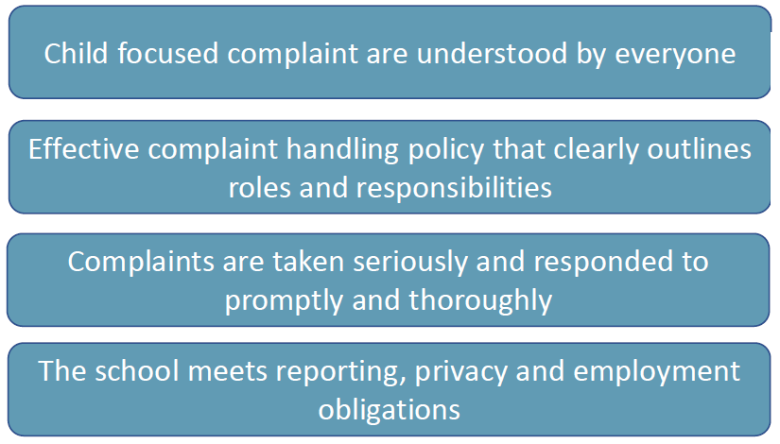
Key elements of Standard 6
Processes to respond to complaints of child abuse are child focused
Notes:
Standard 6 Processes to respond to complaints of child abuse are child focused
Why is this Standard important?
Implementing a child focused complaint handling procedure means people know how to make a complaint and staff know what steps to take to respond. Children are safer when complaints are addressed quickly, thoroughly and transparently, and where the family and community are supported. When the complaint process is child focused, children feel more comfortable and empowered to make a complaint. Child safe organisations use complaints as opportunities to reflect on their practices. Children are at greater risk when organisations prioritise their own reputations over the safety of children.
What should we be doing?
• The organisation has a child focused complaint handling system that is understood by children, staff, volunteers and families.
• The organisation has an effective complaint handling policy that clearly outlines roles and responsibilities, approaches to dealing with different types of complaints, and obligations to act and report.
• Complaints are taken seriously and responded to promptly and thoroughly.
• The organisation meets reporting, privacy and employment obligations.
What questions can we ask to reflect on what we are doing?
• How do we prioritise the safety of all children in our organisation after a complaint is received? (Scenario: student makes a complaint about a teacher, what do we do, how do we respond? Is the child safe throughout the process?)
• How do we make our complaint handling process publicly available and accessible?
• How do we make our staff aware of their internal and external reporting obligations, including reportable conduct?
• How do we record complaints about child abuse?
• How do we embed a culture of reporting?
• How do we support families after a complaint is received?
• What mechanisms ensure the confidentiality of complaints and the investigative process?
• Do adults understand the process and possible outcomes for complaints that are made against them?

Slide 25

Key elements of Standard 8
Physical and online environments minimise the opportunity for abuse to occur
Notes:
Standard 8 Physical and online environments minimise the opportunity for abuse to occur
Why is this Standard important?
Safe physical environments play a significant role in reducing opportunities for abuse to occur. Perpetrators exploit situations where they can be alone with children or use the online environment to extend their connection and influence. An organisation that has areas without natural lines of sight by other adults, or no behavioural expectations when interacting with children in person or online, increases opportunities for harm to occur. Managing risks in physical and online environments can prevent abuse and increase the likelihood that perpetrators are stopped.
What should we be doing?
• Risks in online and physical environments are identified and mitigated without compromising a child’s right to privacy and healthy development.
• The online environment is used in accordance with the organisation’s Code of Conduct and relevant policies.
What questions can we ask to reflect on what we are doing?
• How do we assess and manage risks in the physical and online environments?
• How can we alter the physical environment to increase natural lines of sight?
• How do we consult with children about their views of safety in physical and online environments?
• How do we educate our workforce and parents about behavioural expectations, including online safety?
• How do we educate children about how to stay safe in the online environment?
• How do we balance privacy with the need to provide a safe environment for children?
Identify risks – including how they might happen
Analysing risks – determine the likelihood and the magnitude of the consequence/s
Code of Conduct (behaviour risks)
Evaluate the risks e.g. Low, Medium, High and the consequences
Mitigate the risks
Agreements with third parties

Slide 26
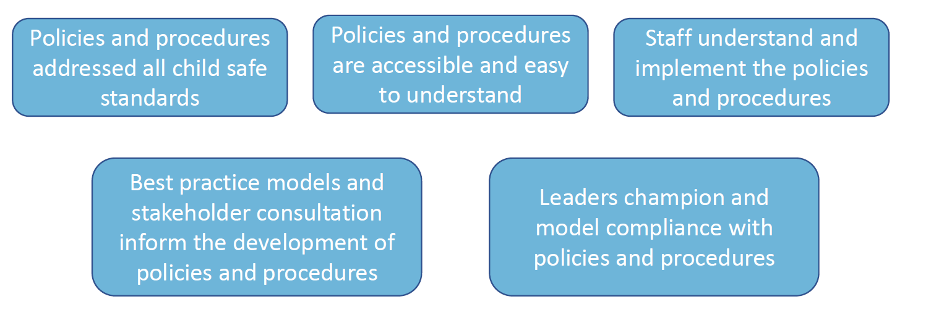
Key elements of Standard 10 – policies & procedures document how the institution is child safe
Notes:
Standard 10 – policies & procedures document how the institution is child safe
Why is this Standard important?
Implemented effectively, child safe policies and procedures provide guidance and clarity to staff, volunteers, parents and children about how to prevent and respond to child safety issues. Without this clarity, individual staff can be left to make their own judgements about complex issues and scenarios – sometimes with poor consequences.
What should we be doing?
• Policies and procedures address all Child Safe Standards and are accessible and easy to understand.
• Best practice models and stakeholder consultation inform the development of policies and procedures.
• Leaders champion and model compliance with policies and procedures.
• Staff understand and implement the policies and procedures.
What questions can we ask to reflect on what we are doing?
• How do we make our policies and procedures specific to our organisation?
• How do our leaders champion a culture of compliance with our child safe policies and procedures?
• Have do we make our child safe policies and procedures publicly available and easy to understand?
• How do staff implement our child safe policies and procedures?
• How do we know staff are implementing child safe policies and procedures?
• How are Codes of Conduct, policies and procedures embedded in all operational aspects of our organisation?
• What happens if policies and procedures are not followed?
We have key policies:
Safeguarding/Child Protection (AAE, ROSH, WWCC)
Code of Conduct (Professional Standards) : Professional Guidelines
Complaints Handling (including reporting)
Risk management
HR (including advertising, recruitment and role check requirements)

Slide 27
ACTIVITY
Leadership, monitoring & improvement
STANDARDS 1 & 9
Engaging with children, families & communities
STANDARDS 2, 3, 4
Right people, right role, right knowledge
STANDARDS 5 & 7
Systems, policies and procedures
STANDARDS 6, 8, 10
Your Role:
What are you doing already?
What does the NCSS mean to you in your role?
What will you takeaway that may be used to assist in improving practice?
Notes:
In response to the question I asked earlier: How do staff implement our child safe policies and procedures?
We won’t have time today, but this is a suggested activity you might consider completing with your School Leadership team.
Slide 27 of your worksheets.
The activity is about reviewing the really good practices you have already embedded. There is also the opportunity to looking at what the National Catholic Safeguarding Standards mean for you in your role. And what can you do to improve practice at your school?

Slide 28
What does all this mean for CSBB?
The three different types of Principles and Standards are relatively consistent – if we are compliant with one set, we will most likely be compliant with all
Essentially, we must adhere to the National Principles but will not be externally oversighted on these
We will be audited by the Office of the Children’s Guardian on the NSW Child Safe Standards commencing later this year or next year
When CSBB signs up with ACSL we will also be audited against the National Catholic Safeguarding Standards
During 2020 the Office for Safeguarding completed a self-assessment against the National Catholic Safeguarding Standards
Notes:
What does all of this mean for CSBB?
The three different types of Principles and Standards are relatively consistent – if we are compliant with one set, we will most likely be compliant with all
Essentially, we must adhere to the National Principles but will not be externally oversighted on these
Why do we need to do this?
Safeguarding is everyone’s business
Being a safe church and organisation is paramount
We do not want to allow abuse to ever occur again
We will be audited by the Office of the Children’s Guardian on the NSW Child Safe Standards commencing later this year or next year
When CSBB signs up with ACSL we will also be audited against the National Catholic Safeguarding Standards
Audits
In preparation for the audits which will likely commence in 2021, during 2020 Tamara completed a Self Assessment against the NCSS to provide a baseline of where CSBB sits in regard to compliance against the standards. The results were very promising however an action and implementation plan has also been developed to improve practice and ensure CSBB is not only compliant with the standards but is working at a best practice level across all areas of safeguarding. We will look briefly at the results on the following pages.

Slide 29
The Structure of the NCSS Standards
111 Indicators
Practical demonstration of each criteria
Will refine and change over time as we test effectiveness of each indicator to contribute to making children safe
49 Criteria
Elements considered to contribute to the achievement of the Standard
Articulated by the Royal Commission, National Children’s Commissioner and ACSL
10 Standards
Researched by the Royal Commission
Reinforced by the National Principles for Child Safe Organisations
In alignment with the NSW Child Safe Standards
Indicators
Criteria
Standards
Notes:
Turning our attention back to the NCSS Standards (refer to Manual)
The NCSS have listed the 10 standards which we have discussed.
They also have listed 49 Criteria that describe the elements of what is needed to achieve the standard as articulated by the RC, Children’s commissioner and ACSL (Australian Catholic Standards Ltd).
Each Criterion is further broken down into a number of Indicators which provide more detail of the actions required to demonstrate implementation of the criterion and the Standard.
For Example:
For Standard 1. on Page 7-9, Criterion 1.1 States that the entity publicly commits to child safeguarding and takes a zero-tolerance approach to child abuse: The NCSS is able to clearly state that it meets that criterion and is able to further demonstrate the Indicators of this. For example the Child Safeguarding Policy that is approved and endorsed by the Church Authority and/or relevant leadership body and is publicly available to church members who work with and have contact with children.
And it makes publicly available and openly displayed, a copy of the Child Safeguarding Commitment Statement.

Slide 30
CSBB audit against NCSS indicators
Out of the 111 indicators, 94 are relevant to CSBB.
Pleasingly, CSBB was compliant across all 94 indicators.
Specifically, 83 indicators have been rated as ‘managed and measured’ and 11 have been scored as ‘defined and developed’.
Notes:
So looking at the Self Assessment that was conducted:
The NCSS were officially endorsed by the Australian Catholic Bishops Conference and Catholic Religious Australia on 30 May 2019.
The Office for Safeguarding (OfS) began to implement safeguarding practices based on the child safe standards identified by the Royal Commission much earlier due to government regulation and more importantly due to its commitment to child protection and safety of children and young people.
As agreed by the DSE, the OfS (CSBB) undertook a self-assessment of the standards in 2020, using a template provided by CPSL. Based on this, a CSBB self-assessment and action plan has been created, which directly addresses the NCSS standards. The focus for the self-assessment and implementation/action plan incorporates the whole of the Diocesan School System including all 44 systemic catholic schools.
There were 10 standards set out in the NCSS and these standards contain 49 criteria and 111 indicators. Out of the 111 indicators, 94 are relevant to CSBB. The 94 indicators were assessed during the self-assessment. Pleasingly, CSBB was predominately compliant across all 94 indicators outlined in the self-assessment, with a score of either “Managed and Measured” or “Defined & Developed” in all indicators listed. Specifically, 83 indicators have been rated as ‘managed and measured’ and 11 have been scored as ‘defined and developed’.
The goals and actions outlined in the implementation plan were primarily geared towards improving the base line of practice that is already in existence within CSBB to an even higher level of practice.

Slide 31
ACSL Audit Framework
All Church Authorities that enter a Service Agreement with ACSL will be subject to audit over a 3 year cycle.
SERVICE AGREEMENT
To establish contractual agreement between ACSL & Church Authorities & gather key entity information.
AUDIT PLAN AND CYCLE
To hold Church Authorities & leaders accountable on a regular basis & ensure ongoing compliance.
3 year cycle
PUBLIC REPORTING
To hold Church Authorities publicly to account while ensuring there isn’t disproportionate individual attention.
Audit Reports published online regularly in groups
Service Agreement
Entity Demographics
Estimated Fee (10% on signing)
Timing of Audit
Self – Assessment
Declaration of Assurance & Compliance for regulated activities
Annual Compliance Exception Report
ACSL Annual Report of yearly outcome & performance
Notes:
ACSL will audit compliance with these Standards, holding the leaders and members of Catholic organisations accountable for the safety of children who come into contact with the Church and its works. ACSL will publicly report audit findings.
Where is this at the moment? It is with the Safeguarding Office at the moment, in due course we will be connecting you with this. Watch this space!
In terms of Action required of Schools
Keep doing what you are doing but consider downloading a copy of the NSW Child Safe Standards and CPSL NCSS guidebooks (which are in the resources folder for this Principal Workshop) and monitor what your school can do better. However, the Office for Safeguarding will take the lead in responding to any audits by ACSL or the OCG so don’t be too alarmed or overwhelmed as most of the standards are checked during the school review & development process anyway and the expectation is that we are predominately already compliant!

Slide 32
Office for Safeguarding http://csochildprotection.weebly.com/
Phone: 9847 0618
Questions?
Notes:
Are there any questions?
(Check time) 10:15am morning tea.

